Slide 2
Back to the feature.....and return
Roberto Freato
Marcello Marchetti
Fabio Santini

Slide 4
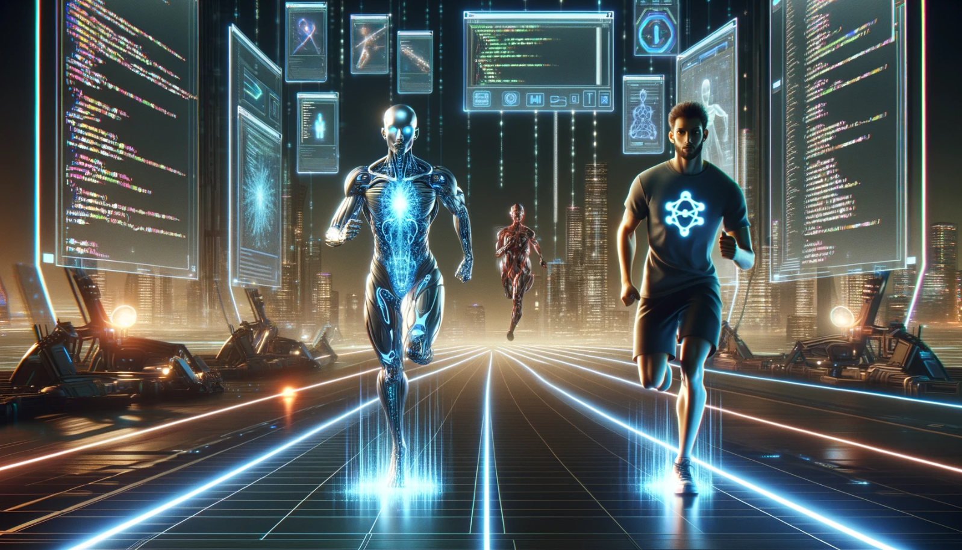
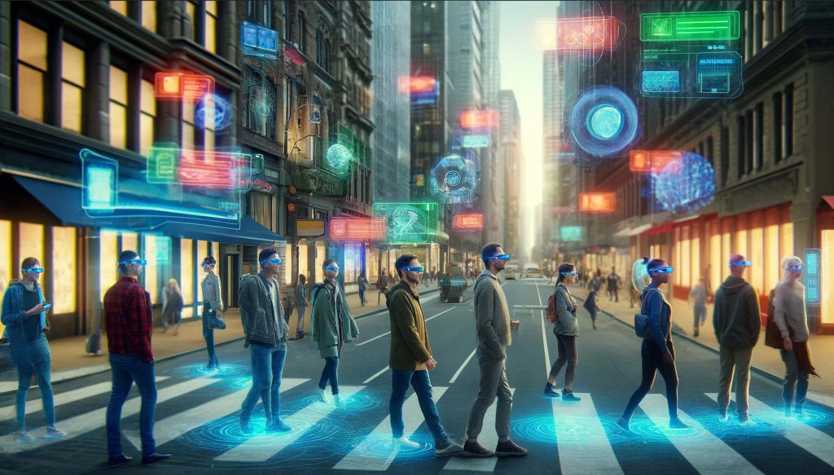
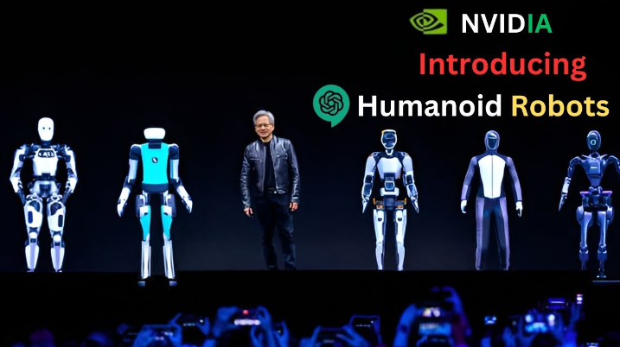
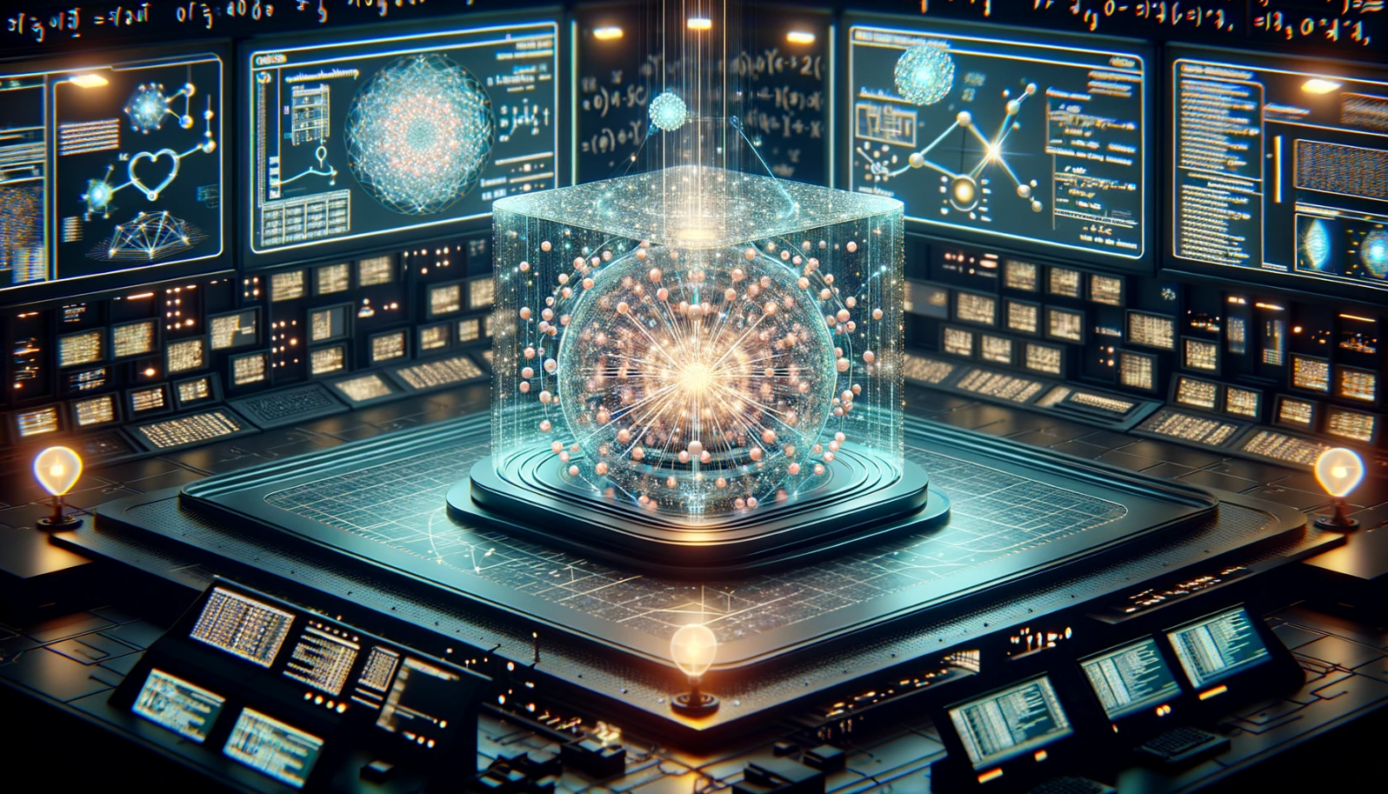
Developer with AI will replace developer
We will wear a second screen all days
Human robots will be part of our life
Quantum computing will change…a lot

Slide 5
AI will not replace developer, developer with AI will replace developer

Slide 6
How Codex works ?
GPT Architecture
Codex is built on the Generative Pre-trained Transformer (GPT) architecture
Training Process
Codex is trained on a diverse dataset comprising both natural language text and billions of lines of code from publicly available sources
Codex is first pre-trained on a large corpus of text data using unsupervised learning
Codex is then fine-tuned on code-specific datasets
Functionality and Use Cases
Codex can generate code snippets and even whole programs in multiple programming languages and styles based on a prompt
The model can complete code snippets intelligently
Codex can also explain code snippets, translating code into a human-readable language
OpenAI Codex is a sophisticated artificial intelligence model developed by OpenAI, designed to understand and generate human-like code. It powers tools like GitHub Copilot, providing suggestions for code and entire programming functions based on natural language prompts or comments in the code.

Slide 7
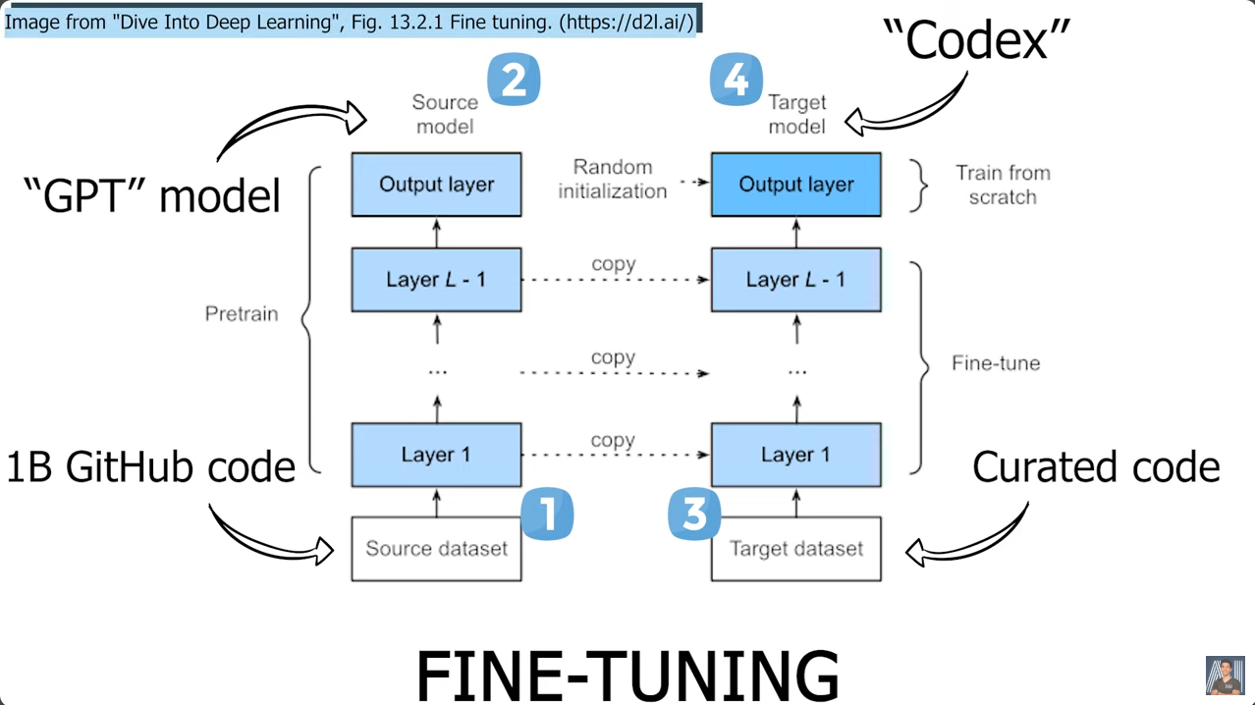

Slide 8
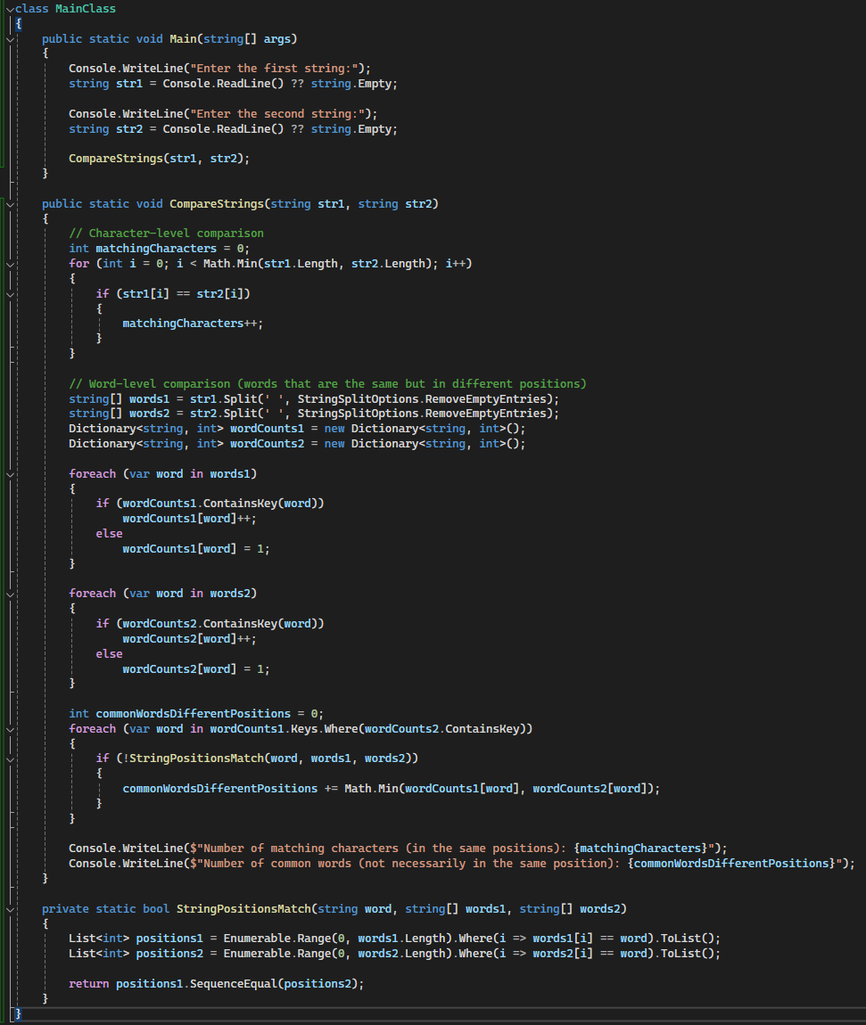
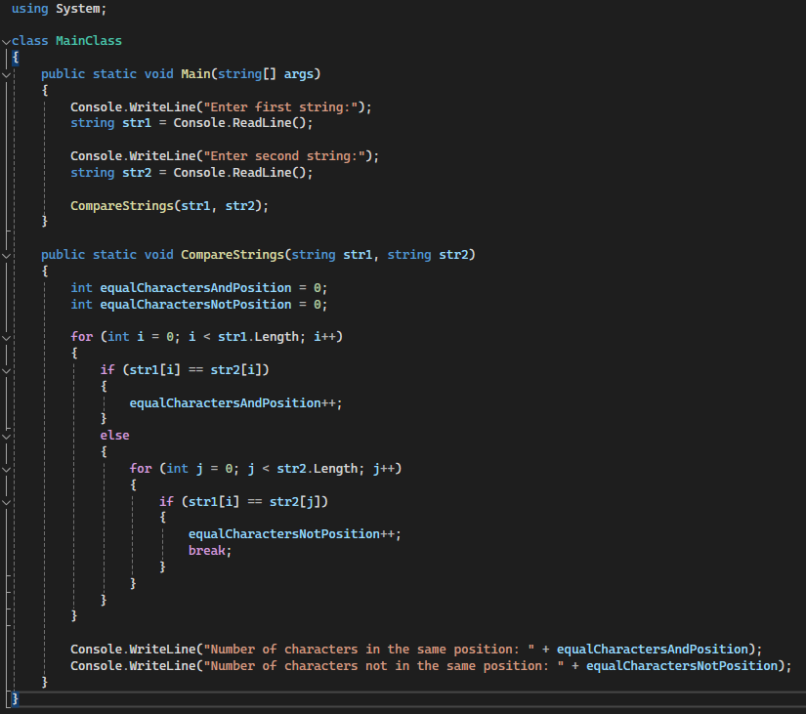
Write a function in c# that takes two string by a user and count how many character are equal and in the same position and how many words are equal but not in the same position

Slide 9
Developers will remain crucial in the development world, but they must adapt and learn new skills
Complementing Capabilities, Not Replacing
Generative AI tools are designed to assist and speed up coding tasks, but they require precise instructions and oversight from skilled developers.
Complex Problem Solving
The ability to understand and solve complex problems is uniquely human and cannot be fully replicated by AI.
Developers' insights are crucial for defining the scope of a problem, ideating solutions, and iterating on feedback.
Navigating Integration and Implementation
Ensuring compatibility, security, and performance standards meet industry requirements are tasks that AI alone cannot fulfill.
Innovation and Creativity
While AI can optimize existing processes, human creativity drives innovation in technology development.
Developers are needed to explore new possibilities, experiment with emerging technologies, and create innovative applications.
Ongoing Learning and Adaptation
The technology landscape is ever-evolving, and continual learning is essential for staying current.
Developers must adapt to new tools and technologies, including AI itself, to remain relevant and effective.

Slide 10
We will wear a second screen all days, we are going to view the world in 3D

Slide 11
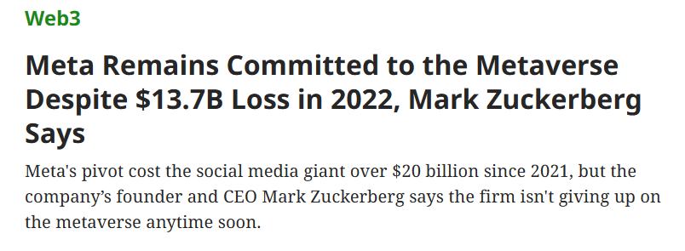
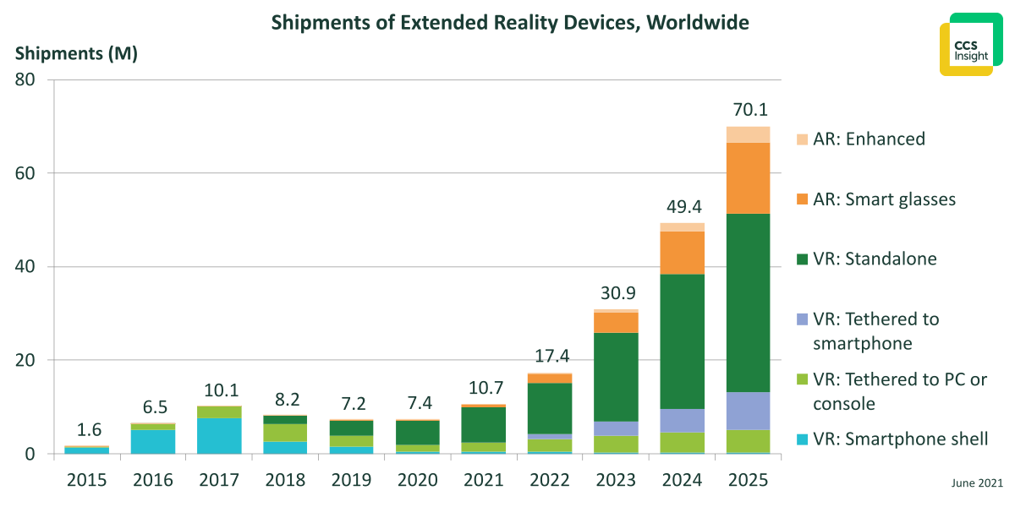
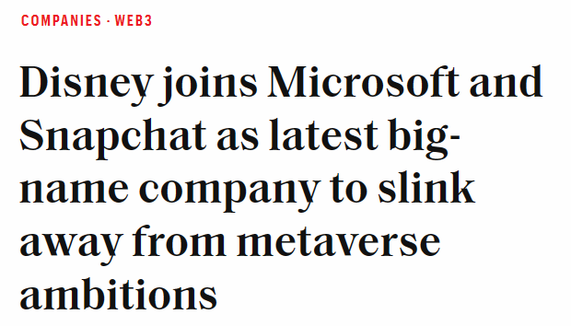
Metaverse vs Extended Reality

Slide 12

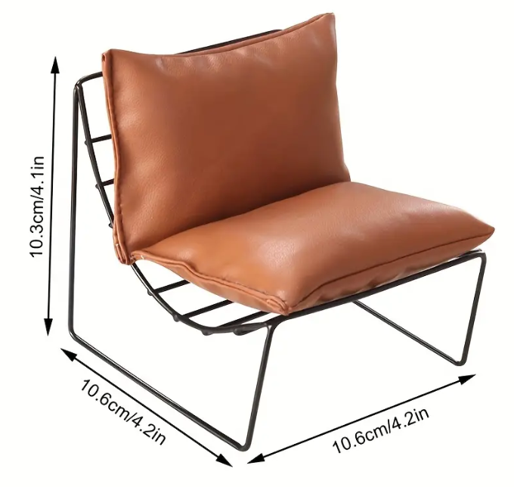
Quiz time

Slide 13
Which technologies to use?
Web
Headset
WebXR API: This is the core technology that enables XR experiences on the web. It provides access to input and output capabilities on both AR and VR devices.
Three.js / Babylon.js: These are high-level JavaScript libraries that make it easier to create and render 3D scenes in a browser. They wrap lower-level WebGL calls and are compatible with WebXR for immersive experiences.
A-Frame: This is a web framework for building VR experiences. It is built on top of HTML, making it accessible for web developers without deep knowledge of WebGL.
React 360: Created by Facebook, this framework is designed for building interactive 360-degree experiences that can run in web browsers and on VR headsets.
Unity: One of the most popular game development platforms, Unity offers robust support for VR and AR development across multiple headset types. It provides a wide range of tools and assets for immersive content creation.
Unreal Engine: Known for its high-fidelity visuals, Unreal Engine is another powerful choice for creating VR and AR experiences. It supports various VR platforms and is favored for high-quality graphics and complex simulations.
SteamVR: This is a full-featured platform for VR development, supporting major VR devices like HTC Vive and Oculus Rift. It integrates with both Unity and Unreal Engine.

Slide 14
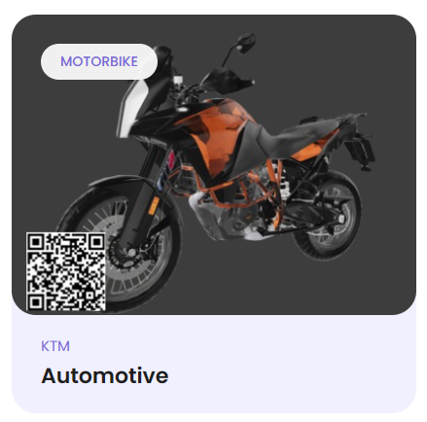
Demo

Slide 15
AI + Computer Graphics + Physics will create human robots that will be part of our life

Slide 16
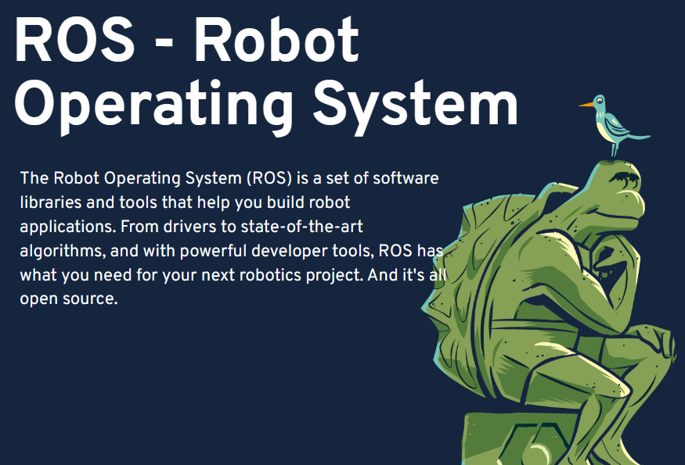
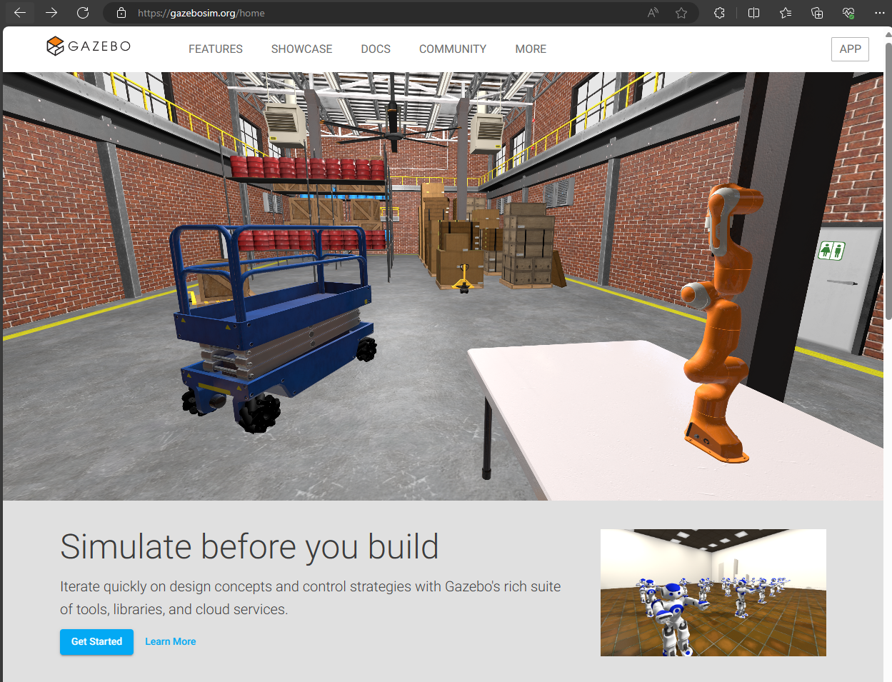
Where to start ?
ROS: Home
Gazebo (gazebosim.org)
it - ROS Wiki

Slide 17
Quantum computing will change everything … well not everything… a lot

Slide 18
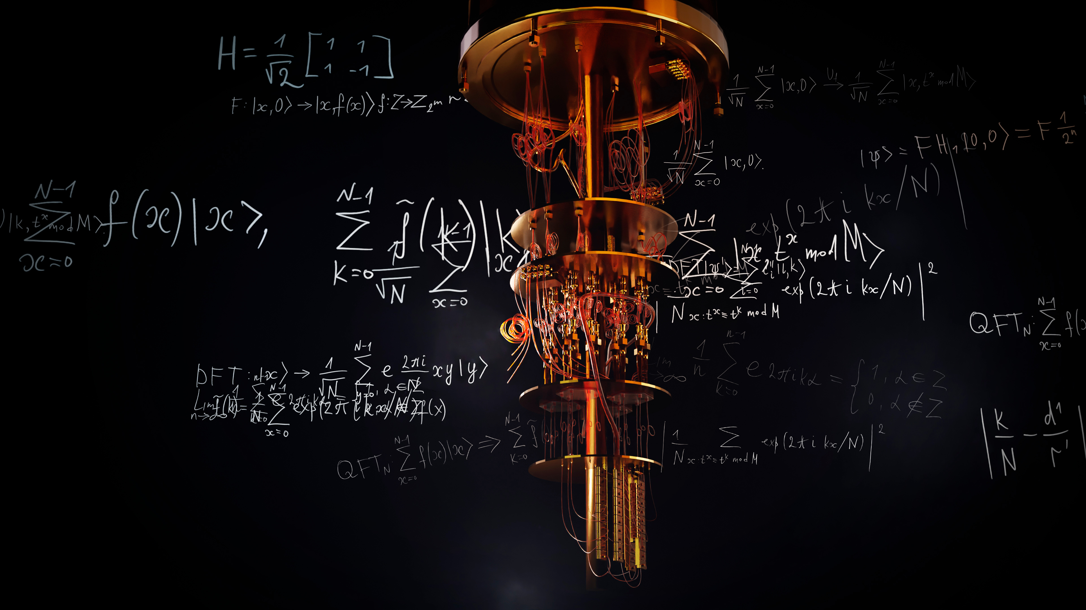
Quantum computers compute on electrons and particles (Qubit), which act like waves, that could be in two places at the same time (Superposition) that's what gives quantum computers their power.
Furthermore, the Qubits can be linked together so that the state of one qubit instantly affects the state of another, even at enormous distance (Entanglement)
They compute on not just one universe but an infinite number of parallel universes.

Slide 19

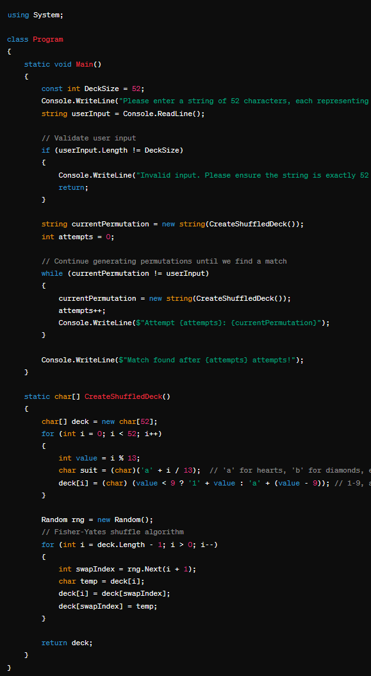
We use 1000 32-core processor AMD's Ryzen Threadripper which can perform 11.076.923.076 comparison per minute.
We run all the 1000 CPUs for 1000 years.
How many comparison our system can do ?
Total number of comparison = 5.82203E+21
How many permutations a deck of cards has ?
Total number of permutations : fact(52) = 8.06582E+67
With 1B years and 1B of CPUs we can reach 5.82203E+33
Simple problem
We have a deck of 52 cards
We ask the user to make a prediction of 1 possible setup
We shuffle the deck every time and we have to find the number of attempts to find the user prediction.
Let’s pretend we are not repeating equal permutations

Slide 20
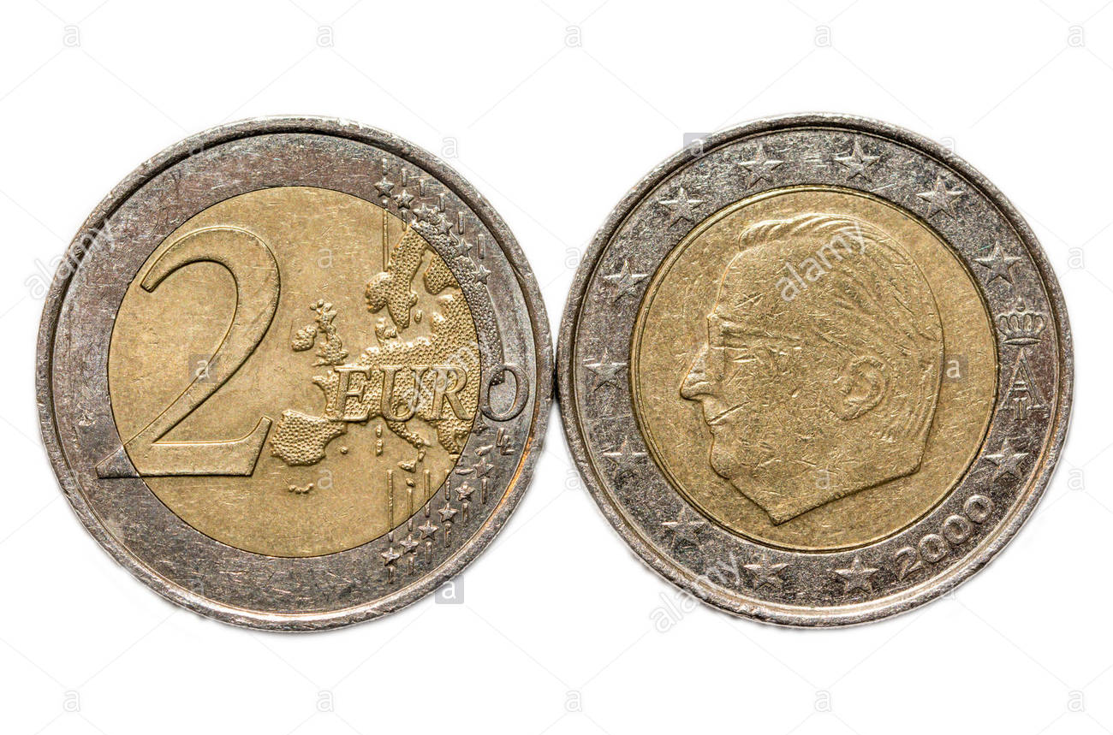

Slide 21
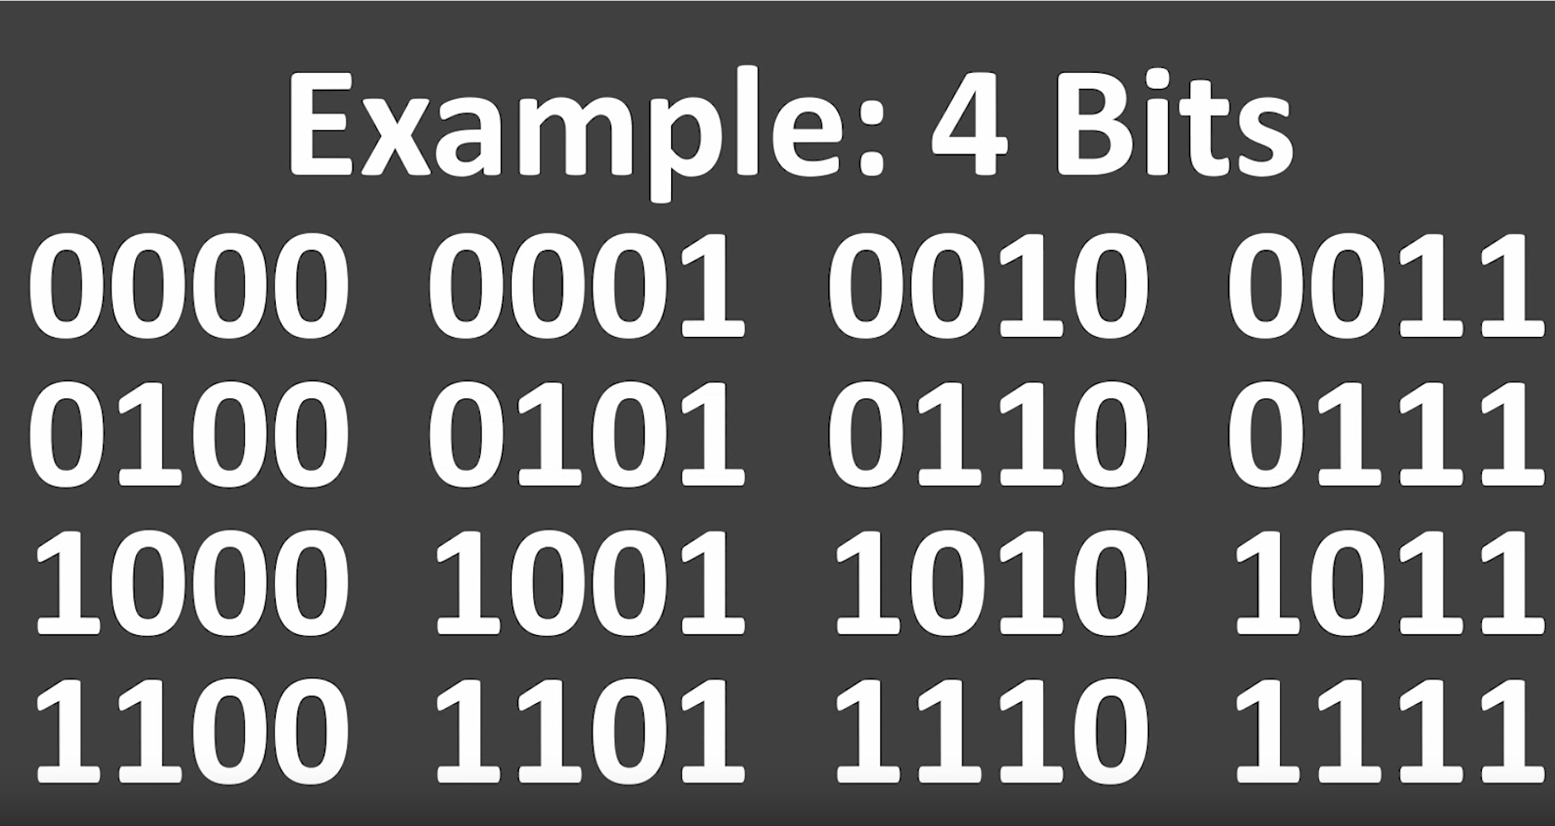

Slide 22
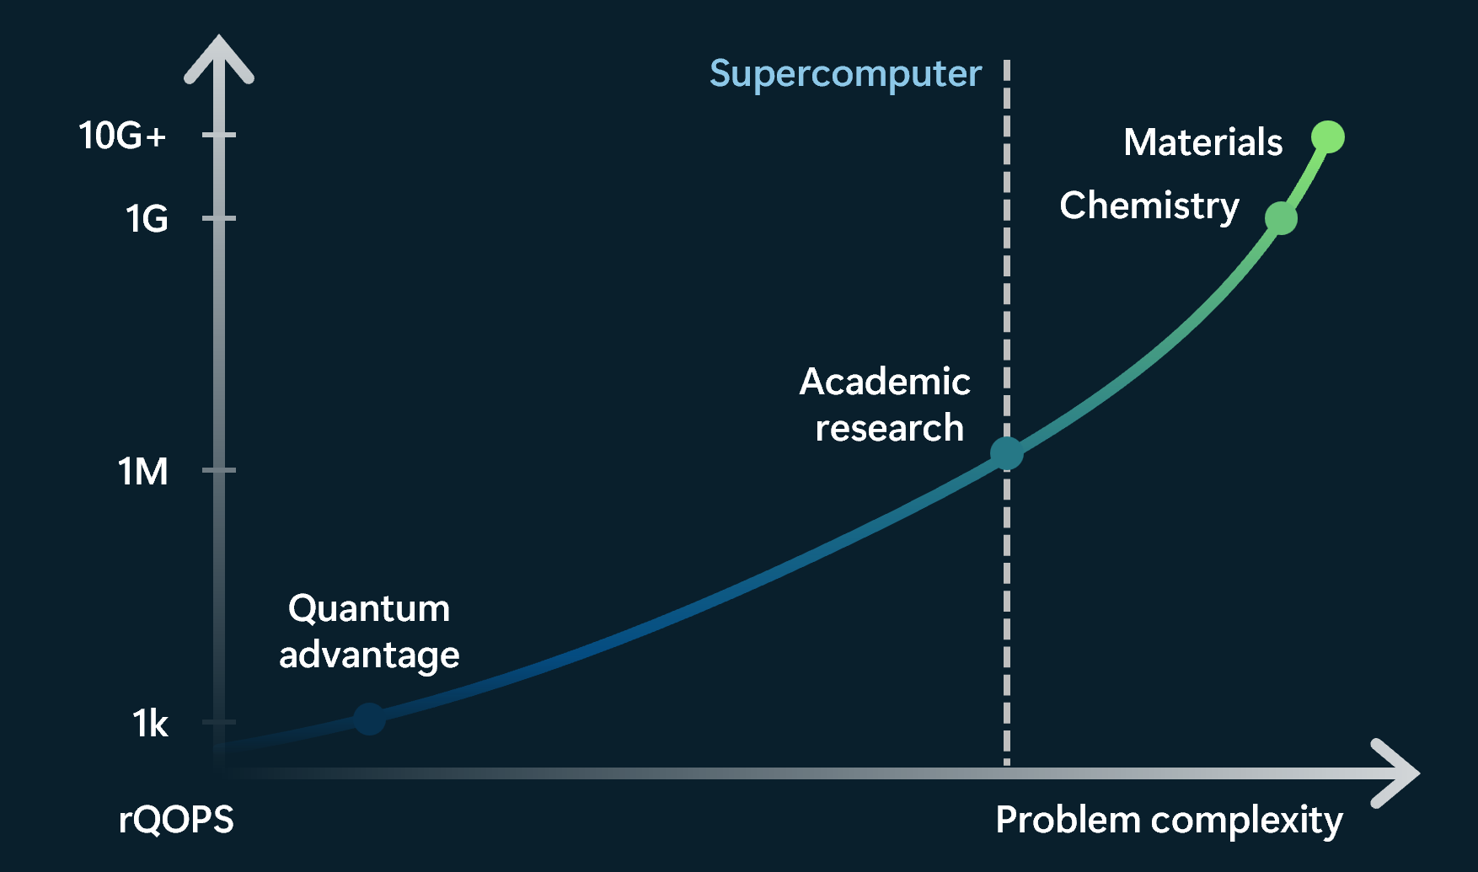
A new metric for the industry to measure progress
From qubit counting to reliable Quantum Operations Per Second (rQOPS)
Impact from quantum computers requires reliable quantum operations in a machine that can remain stable for hours to weeks
rQOPS measure the number of reliable quantum operations per second, similar to peak FLOPS in classical HPC.
A quantum supercomputer has to be able to perform a quintillion (10^18) logical operations while making at most one error
Today’s NISQ quantum computers are all performing at the same rQOPS value: 0

Slide 23


Slide 24

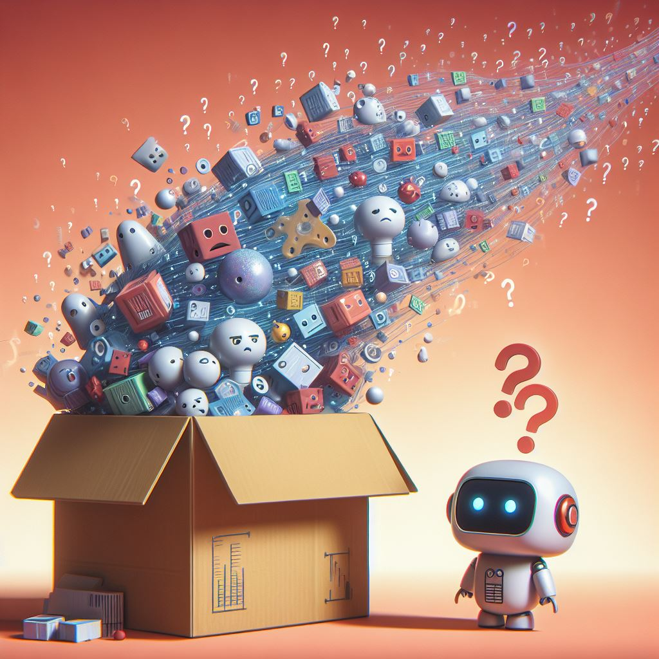
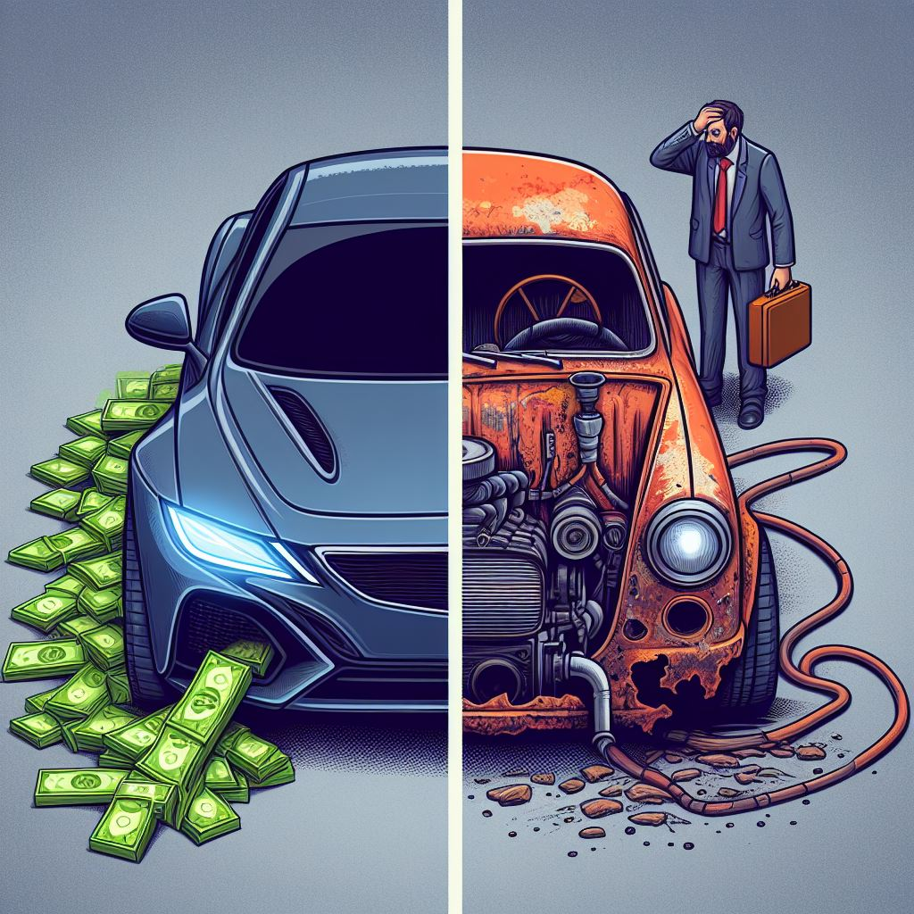

(some) Main Challenges
Data Ingestion
Retrieval
Performance / Cost
Monitoring

Slide 25









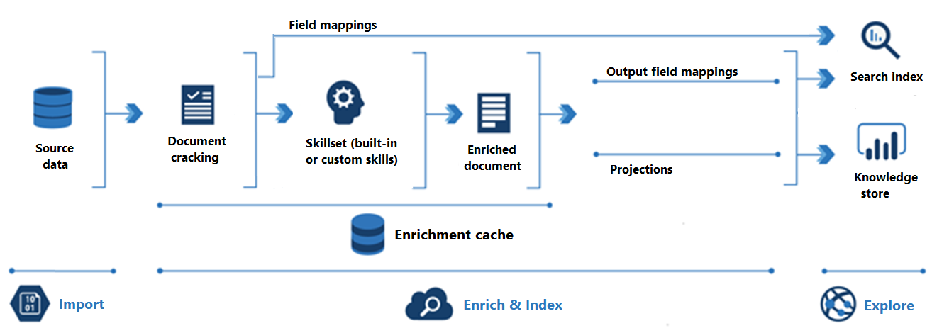

Pre-Processing
Structured Data
Custom Logic
Chain-of-Thought
Chain-of-Table
Unstructured Data
Enrichment (skills)
Chunking
Data Ingestion

Slide 26

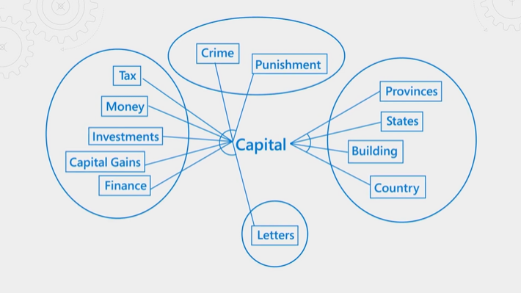


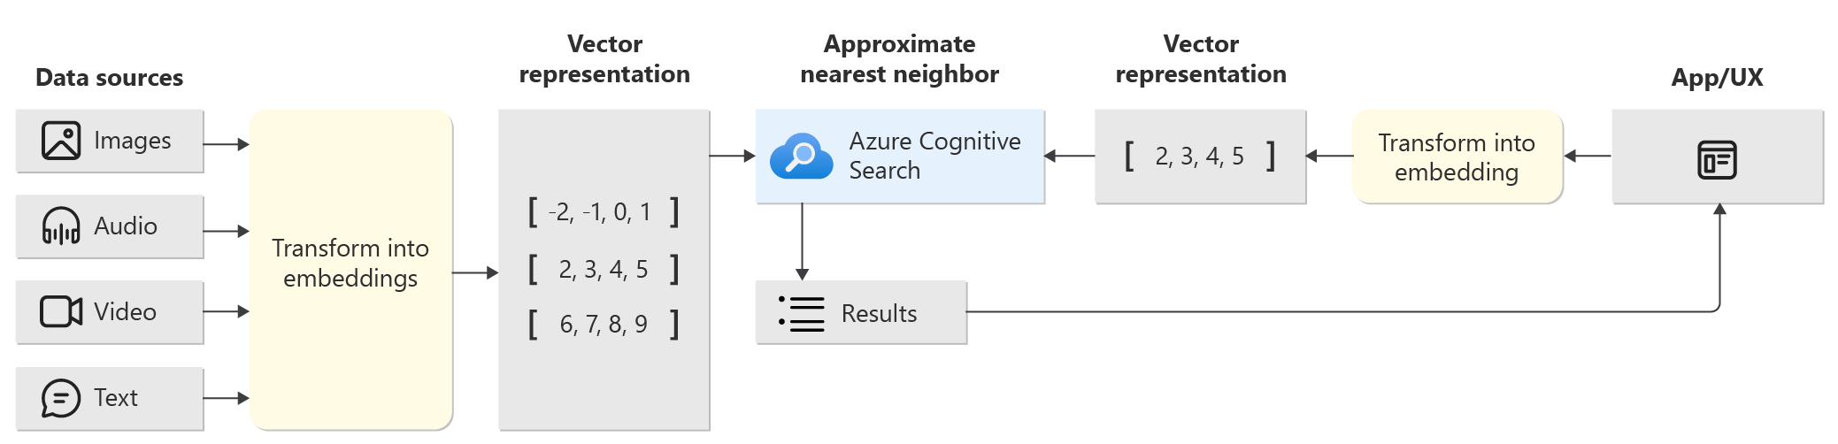
Query Routing
Query Augmentation
Reranking
Task-Based
Semantic (ranking)
Not in Context
Vector (search)
Optimization
Retrieval

Slide 27




PTU
vs
PAYG
Monitoring
Search limits
Performance / Cost

Slide 28


















[Enqueue Reindexing]
[Conversation History]
[Get Indexer Status]
Error 429
[Prompt]
Error 429
[Trigger]
[Answer]
[Endpoint Config]
XR Copilot
srch-001
[PerformIndexing]
[Run Indexer]
[Endpoint Config]
[System Data]
Srch-099
[UploadFile]
H-Share CMS
[Endpoint Config]
[System Data]

Slide 29
[Enqueue Reindexing]
[Conversation History]
[Get Indexer Status]
Error 429
[Prompt]
Error 429
[Trigger]
[Answer]
[Endpoint Config]
XR Copilot
srch-001
[PerformIndexing]
[Run Indexer]
[Endpoint Config]
[System Data]
Srch-099
[UploadFile]
H-Share CMS
[Endpoint Config]
[System Data]

Slide 30
[Enqueue Reindexing]
[Conversation History]
[Get Indexer Status]
Error 429
[Prompt]
Error 429
[Trigger]
[Answer]
[Endpoint Config]
XR Copilot
srch-001
[PerformIndexing]
[Run Indexer]
[Endpoint Config]
[System Data]
Srch-099
[UploadFile]
H-Share CMS
[Endpoint Config]
[System Data]

Slide 31
[Enqueue Reindexing]
[Conversation History]
[Get Indexer Status]
Error 429
[Prompt]
Error 429
[Trigger]
[Answer]
[Endpoint Config]
XR Copilot
srch-001
[PerformIndexing]
[Run Indexer]
[Endpoint Config]
[System Data]
Srch-099
[UploadFile]
H-Share CMS
[Endpoint Config]
[System Data]

Slide 32

DEMO
XRCopilot

Slide 33
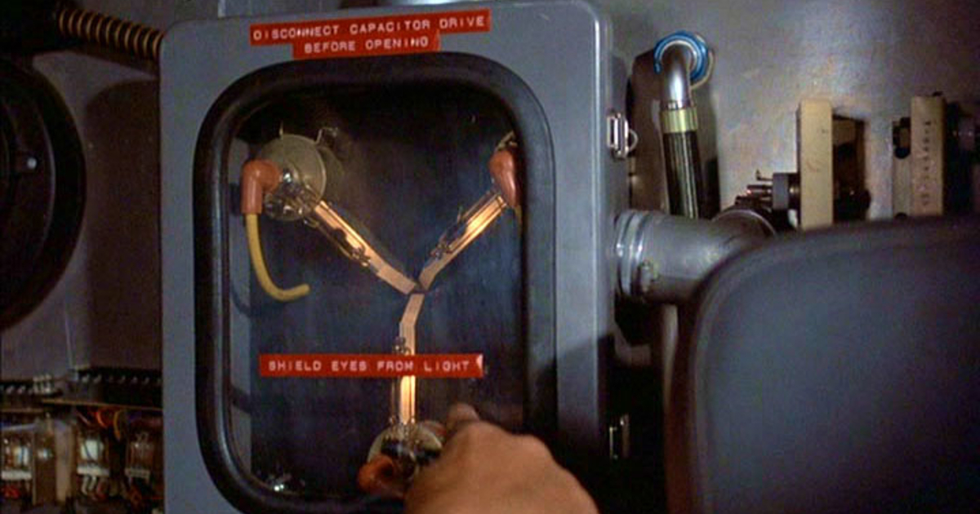
Useful links
AI Enrichment
AI enrichment concepts - Azure AI Search | Microsoft Learn
Smart Load Balancing (API Management)
https://github.com/azure/apim-aoai-smart-loadbalancing/
OpenAI Monitoring
Monitoring Azure OpenAI (microsoft.com)
OpenAI Benchmark
https://github.com/Azure/azure-openai-benchmark

Slide 34


Slide 35
“The Ring AI grants the bearer a power that is proportional to the one they already have”
J. R. R. Tolkien
Roberto Freato

Slide 36
The anatomy
of innovation
1. Slow start, research, first steps
2. Boom
3. Arms race
4. Stabilization
5. Commodity

Slide 37

WE NEED TO
Empower

Slide 38

WE NEED TO
Control

Slide 39
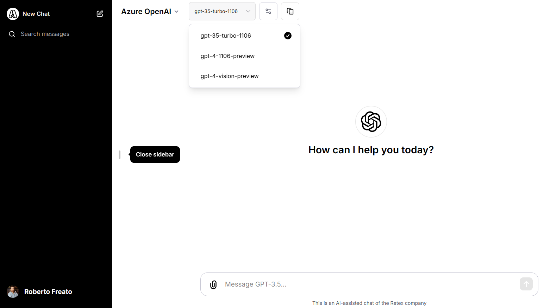

Slide 40
Let's do it

